Slide 1











UDF Platform Introduction
DUA-0001-2508
The Global Pioneering Cross-Border Business Service Infrastructure
Connecting cross-border business services:
"Information" + "Business " + "Professionals"
Bridges the Perception and Trust Gap
Key Markets: MENA | EU | APAC
10 Great Reasons to Choose UDF
01
Elite Network, Top 20% Partners
UDF selects only the top 20% of elite partners, all verified by third-party ratings. You’re guaranteed to work with the best in the industry.
06
High-Threshold Ecosystem
Over 50% of our institutions are licensed, and our invitation-only client referral system ensures exclusivity and trust.
02
9+ Years of Expertise
With over 100,000 hours of frontline client service experience, UDF delivers professional service like no other.
07
Effortless Solutions
Find, understand, and apply solutions quickly. UDF saves you time and effort.
03
Cost-Effective Reach
Connect with 30 million professionals at just 1/10th the cost of major platforms.
08
Complete Confidentiality
We carefully select promotional materials to minimize competitor attention, keeping your business private.
04
Unlock the Chinese Market
Access 50,000+ Chinese companies without needing to speak Chinese. UDF bridges the gap.
09
Your Language, Our Priority
While English dominates online, UDF gives you the edge in Chinese. Join us and lead 90% of competitors.
05
Boutique Marketplace Experience
UDF is like a specialized boutique, tailored to your unique business needs.
10
Trusted by Experts
UDF is the definition of fortitude—trusted expertise for your specialized business world.
2025 Q1-Q2 UDF Platform Top 10 Client Distribution
No. | Country | Service Name | Top 3 Industries
1 |  | BA-001 Brand Value Premium Package | Exhibitions, AI Applications, Aviation
2 |  | CBD-002 Key Channel Expansion | Finance, Investment Promotion, HR
3 |  | PM-002 Purchaser Service Package | Smart Cities, Construction, Legal
4 |  | MBD-003 Business Promotion Conference Service | Finance, Legal, AI Applications
5 |  | UBPr-005 Joint Brand Promotion | Finance, Information Services, Agriculture
6 |  | CP-005 Content Marketing | Information Services, Finance, Legal
7 |  | BA-25-02 Brand Shared Package | Finance, Energy, Investment Promotion
8 |  | MBD-003 Business Promotion Conference Service | Finance, Energy, Aviation
9 |  | CP-005 Content Marketing | Information Services, Finance, Fintech
10 |  | PM-002 Purchaser Service Package | Finance, Energy, AI
Page 1

Slide 2





















UDF Exclusively for Cross-Border Institutions
Deep Connections. Deeper Trust. Global Reach.
Key Partner Benefits of the UDF Platform
For Enterprises
Strategic Supply Chain Resilience
Global Brand Elevation
Seamless Cross-Border Expansion
Relationship-Powered Growth
For Business Service Enterprises
Enhanced Global Brand Recognition
Service Portfolio Differentiation
Cross-Border Service Expansion
Collaborative Professional Network
For Media Partners
Media Resource Sharing
Increased Market Share
Expanded Overseas Revenue
Distinctive Competitive Advantages
For Government, Associations, and Institutions
Global Brand Promotion
International Business Collaboration Opportunities
Targeted Recruitment of Companies / Students / Members
Access to High-Quality Business Audiences
For AI-Related Industries
Worldwide Brand Promotion
Cross-Industry AI Integration
Integrated Domestic and International Services
Accelerated Innovation Network
Page 2

Slide 3


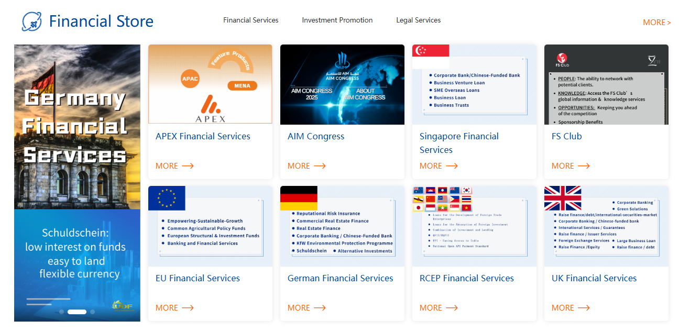
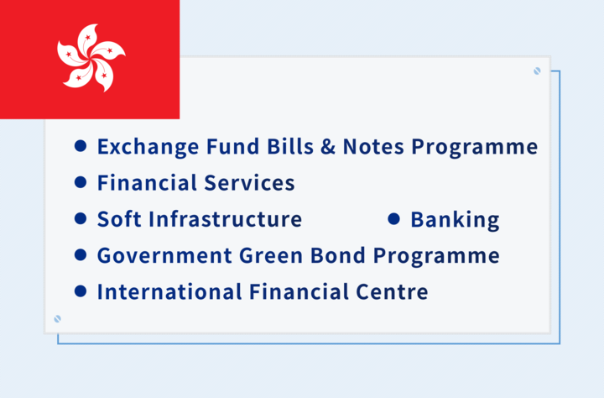

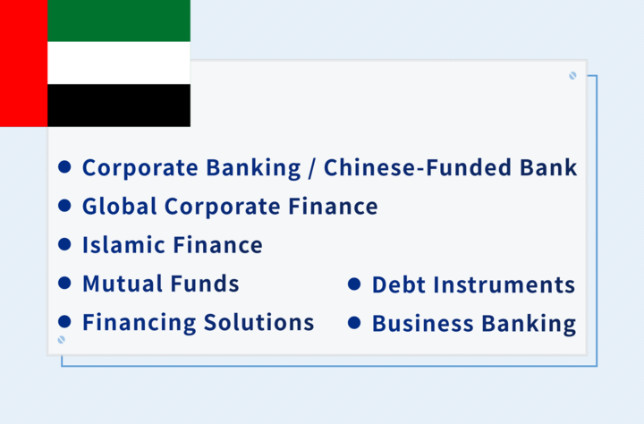

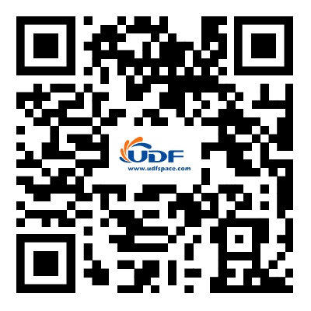

Our Service
Online Store, Roadshow Hall, Brand Promotion, Digital Marketing,
Key Partner Outreach, Tailored Consulting, etc..
Branding
◉ Boost Brand Awareness & Trust
◉ Build Competitive Moat
Channels
◉ Expand Core Business Channels
◉ Deepen Regional Market Penetration
HK Financial Services
UAE Financial Services
Client
◉ High-value Client Conversion
◉ Localized Service Network
Beyond Time and Cost Savings
Ensuring Confidentiality and Compliance
Cases of Specific Service
Emerging Market Expansion for a Qatar Energy Group
Business Expansion in Asia-Pacific for a Saudi Arabia Agricultural Group
Promoted brand awareness through targeted campaigns and expanded partnership channels. Managed government relations, coordinated supplier networks, and operated a remote business center offering trilingual (Chinese, Arabic, English) support.
Developed a strong bilingual(Chinese and English) online presence and enhanced brand image. Successfully ran Chinese social media marketing campaigns, streamlined supply chain management, negotiated contracts, and provided comprehensive day-to-day business support.
Digital Marketing for a German Higher Education Training Program
2025 AIM Congress
Communication & Promotion
Successfully boosted brand recognition with bilingual marketing strategies, attracting English and Chinese-speaking students. Strengthened presence in the education sector with targeted campaigns.
As an official media partner, UDF Platform fuels AIM Congress with cutting-edge content marketing and brand amplification, turning conference breakthroughs into business momentum for the right audience.
Content Marketing for an Abu Dhabi Financial Services Firm
Norwegian Investment Fund Collaboration for Chinese Clients
High-quality bilingual content increased brand visibility and client engagement across local and global markets, strengthening the firm's presence in key regions.
Strategic outreach helped build valuable partnerships with Chinese clients. Expanded business opportunities through personalized communication, establishing long-term relationships in the Chinese market.
Contact Us
BD@u-sharing.com
https://www.udfspace.com/
Cooperation Consultation
Page 3

